Slide 1

SQL Project Airbnb
Group 007
Aashna, Charlene, Sandhya,
Udisha, Ziqi

Slide 2

Agenda
Business Scenario
Swimlane Diagram
ER Diagram & Dataset Creation
SQL Queries (Basic & Advanced):
Popular Room Type
Highest Demand
Top 5 properties & Accommodations/Property
Payment method
Ratings & Amenities
Tableau Dashboard
Learnings & Conclusion

Slide 3
Business Scenario
Kenneth and his friends are going to have a trip to Hawaii during the winter holidays. They plan to go from December 21 to December 27, 2021. They’re looking for a house that could fit in 8 people on the Airbnb website. Other than that, they also want to find a house with a balcony and additional amenities such as Wifi and pool. After adding these requirements, a list of choices are shown. They check the images, amenities, room types, reviews, and price range from a few options. They have a few questions regarding the heating situation in the room, so they message the host through the website at 10:30 pm on November 30. Once the host responds to their satisfaction, Kenneth requests for a reservation on the entire condo hosted by Ken on December 2 around 6pm, which has a 4.78 review score with 23 reviews. Each night costs $750 and the total cost for six nights is $5971 including cleaning and service fee before tax. Kenneth inputs his credit card details when requesting a reservation.
Ken receives a notice via Airbnb that there is a reservation request from December 21 to 28 on December 2. He accepts the reservation on the same day right after the notification, and the website deducts money from Kenneth’s card. He makes a note on these dates, sends a greeting message to Kenneth and confirms the reservation within 24 hours.
After spending the holidays in Ken’s house, Kenneth shared the great thanks and wrote a detailed review with 5 stars for this experience within 14 days. Ken also leaves Kenneth a 5-star review.

Slide 4
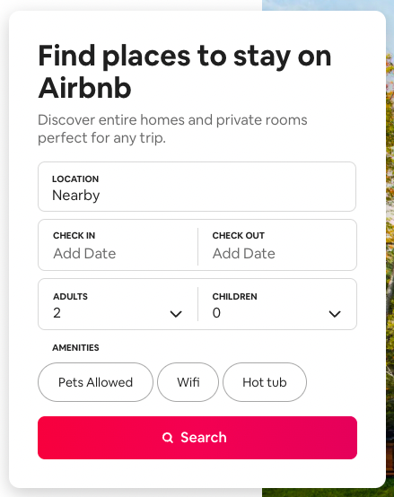
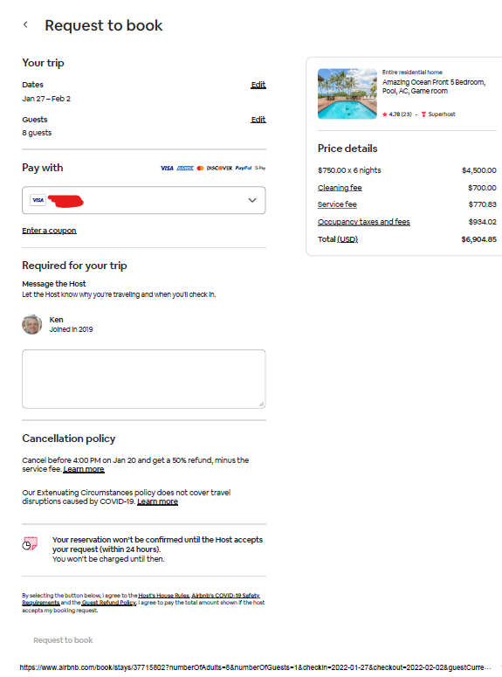
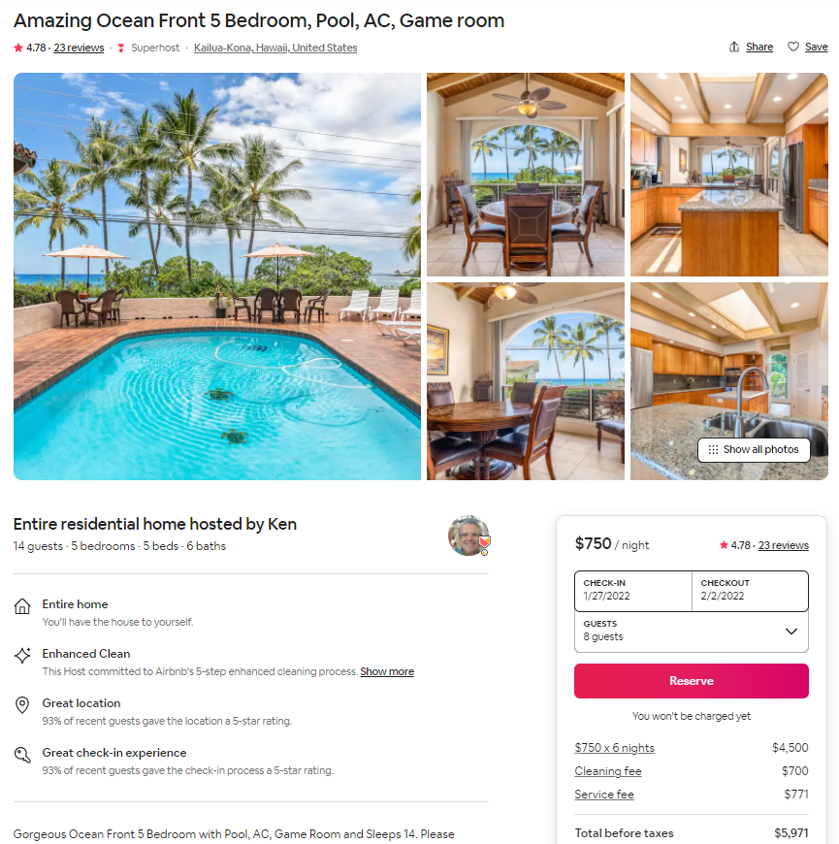
Airbnb Booking Process

Slide 5
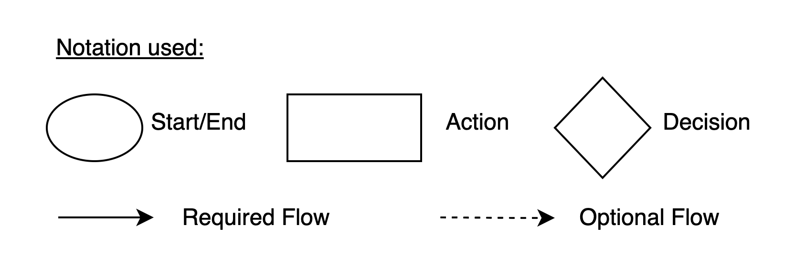
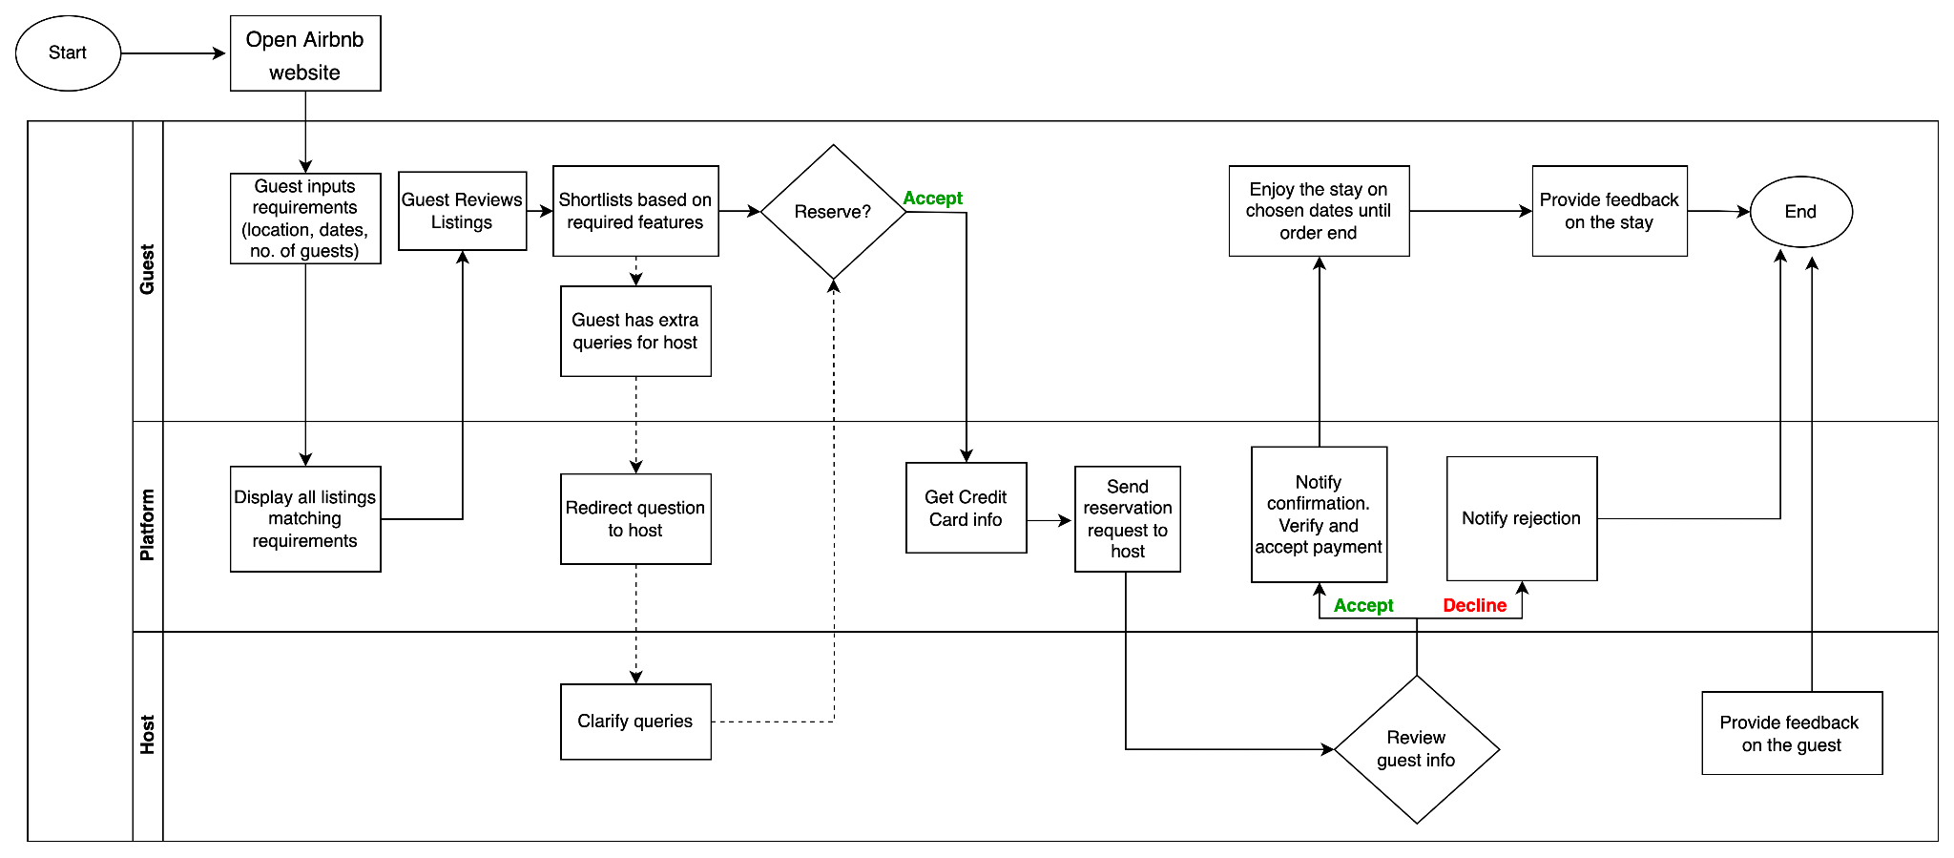

Swimlane Diagram

Slide 6








Tables Required
Customer
Order
Payment
Payment Method
Property
Host
Feedback
Room type

Slide 7
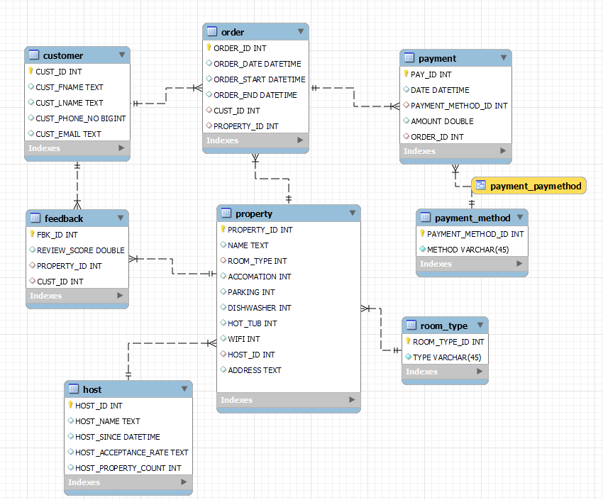
Entity
Relationship Diagram
Steps to create ER diagram when we already have a schema:
1. Click on Database
2. Choose Reverse Engineer
3. Select Schemas (airbnb)
4. Select Objects (tables and view) 5. Execute

Slide 8
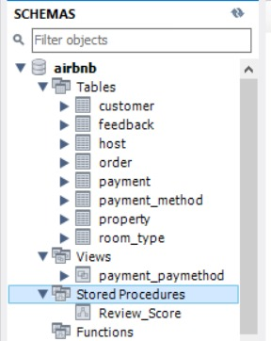
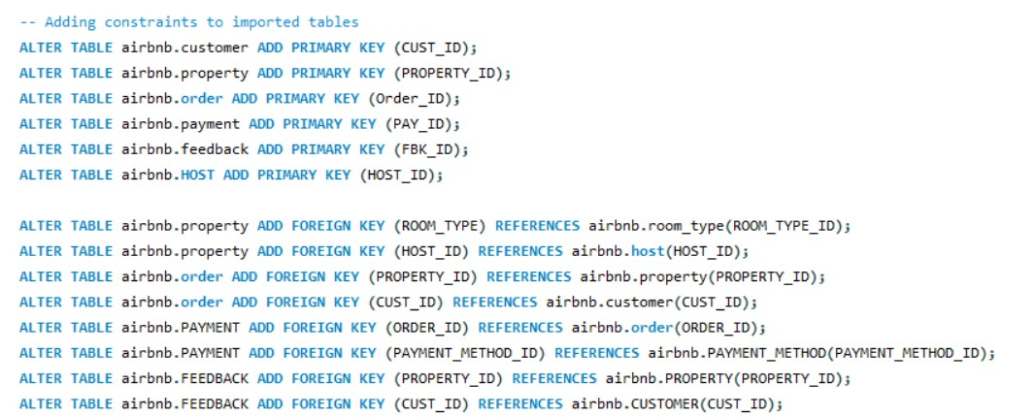
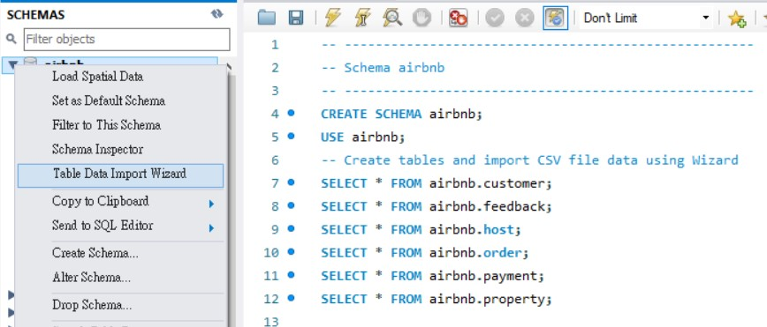
Database Creation
Resulting schema and tables:
Steps to create Database:
Created data and csv tables - spreadsheet with tables
Create MySQL tables for csv import
Import csv in MySQL using “Table Data Import Wizard”
Select files to import, set the destination table and additional options
Configure import settings (assign appropriate data type)
Add Primary Key and Foreign Key for imported tables
For tables only have a few columns and row, creating the tables directly
Step 3:
Step 6:

Slide 9
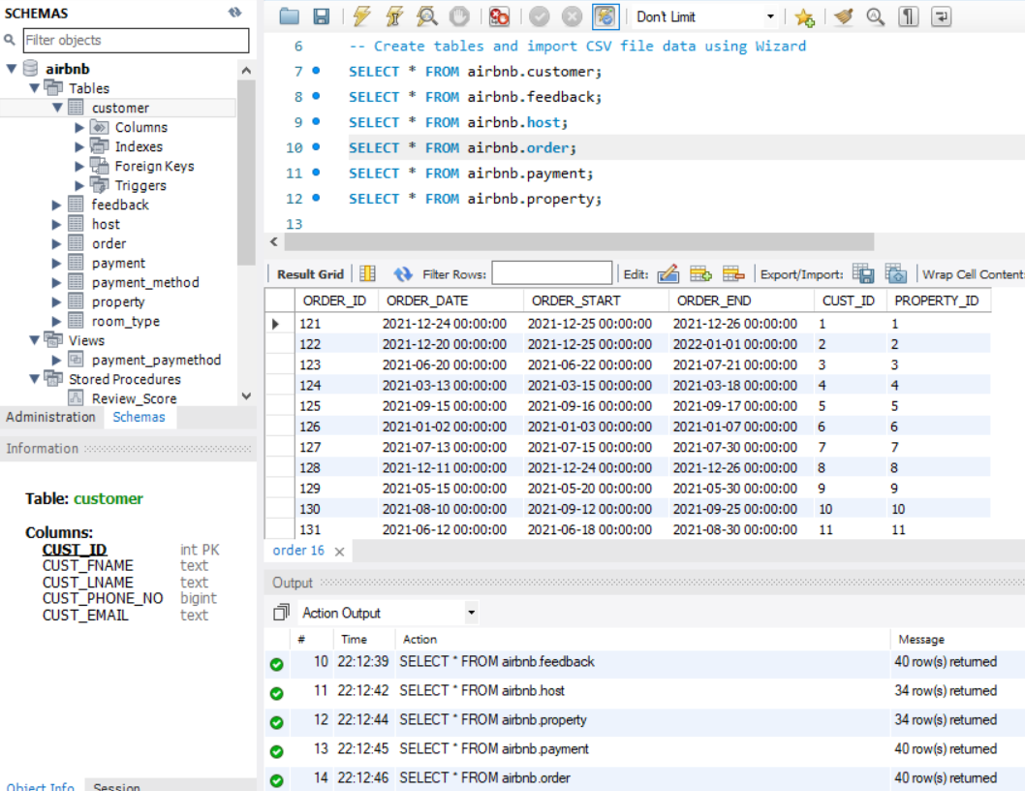
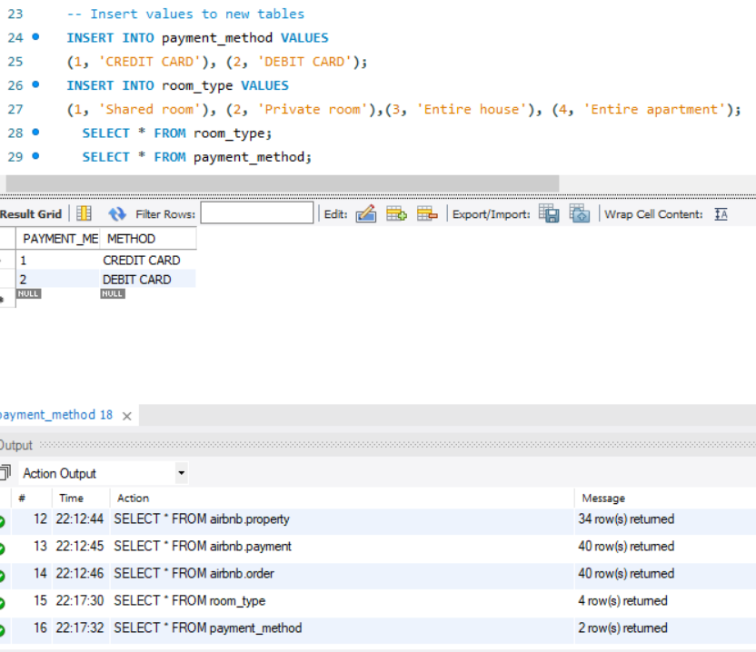
Database
Creation
Complicated data table(>5 rows): Import data from .csv files (6 main tables)
Simple data table (<5 rows): Insert data directly for “room_type” & “payment_method”
Step 7:

Slide 10
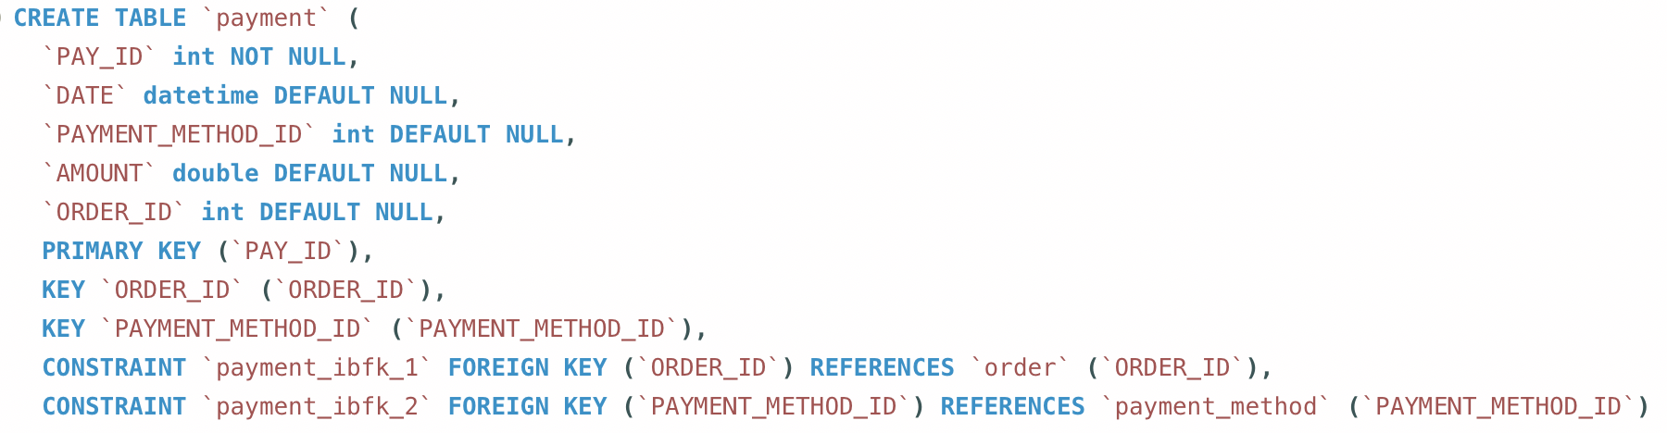
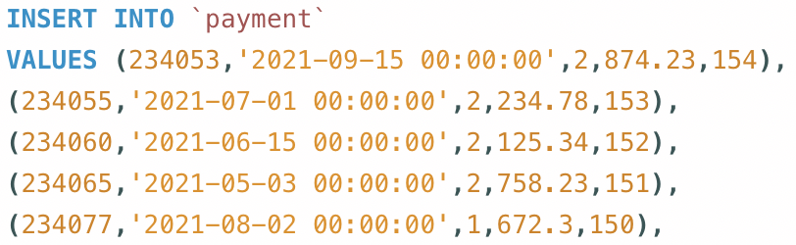
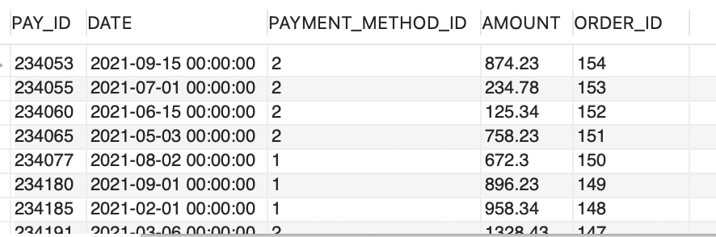
Database Creation Example
Step 1 (DDL):
Step 2 (DML):
Result with PK and Foreign Key from Payment method table:

Slide 11
10 Business Queries using the
Data Query Language

Slide 12
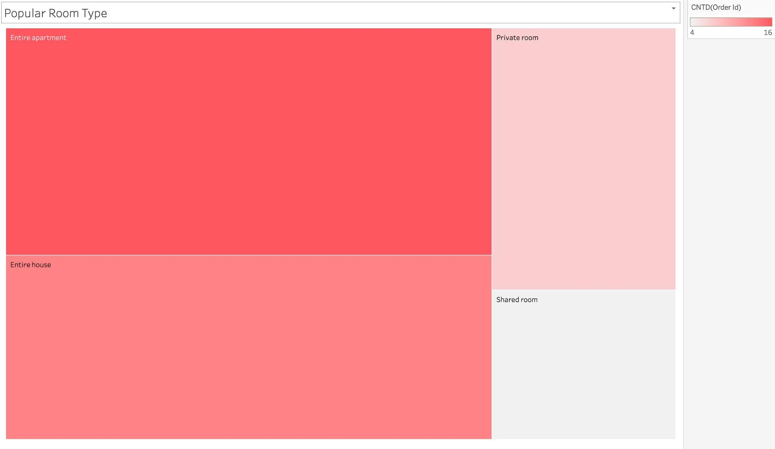
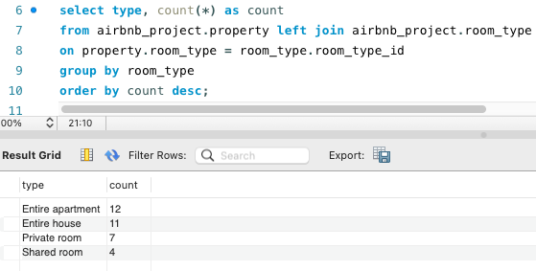
What is the most Popular Room Type?
Using Left Join
The most popular house types are “Entire Apartment” and “Entire House”, because this is unique to airbnb and more convenient for families, as compared to hotels

Slide 13
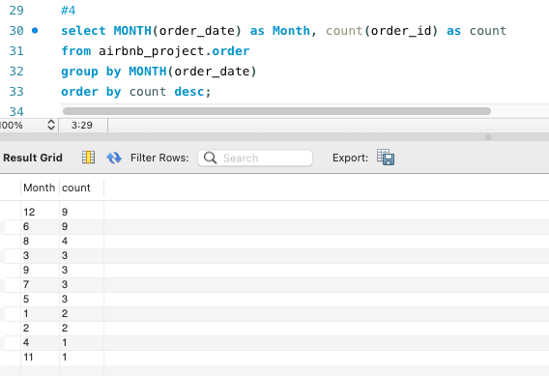
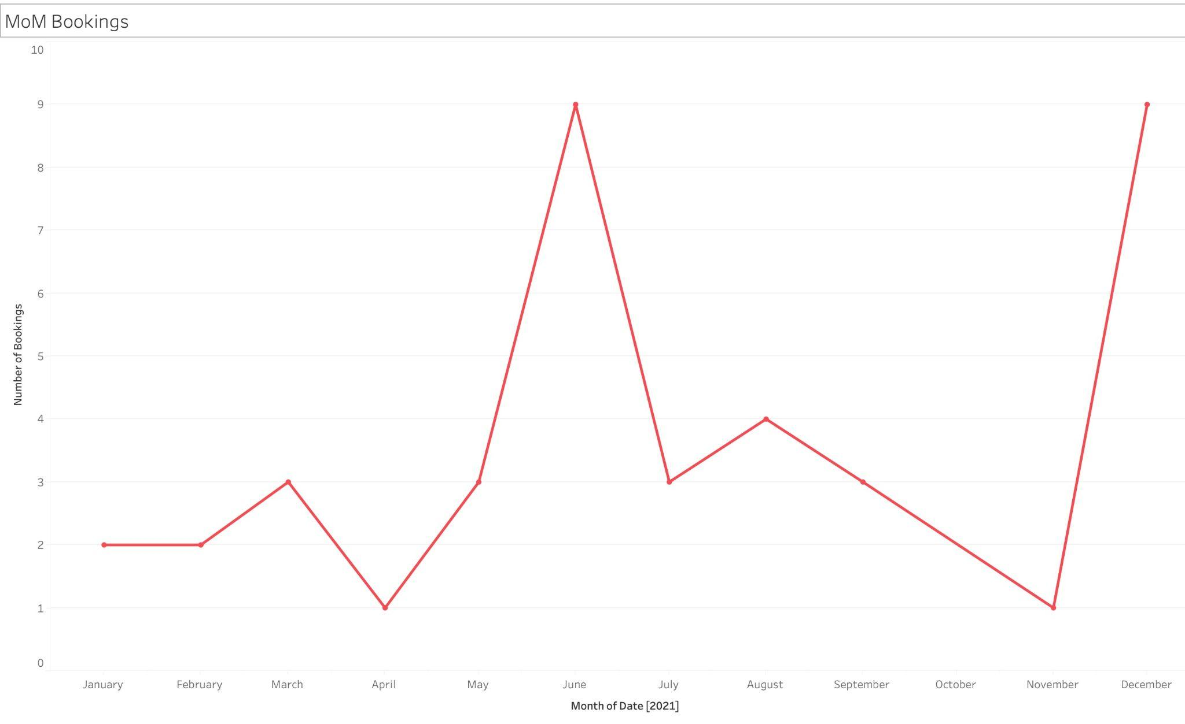
2. What time of the year is there highest demand for airbnbs?
June and December months see the highest demand due to holiday season.

Slide 14
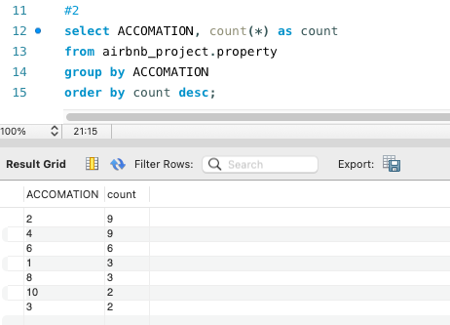

3. What number of accommodations per property is most common?
Most properties accommodate 2 or 4 people.

Slide 15
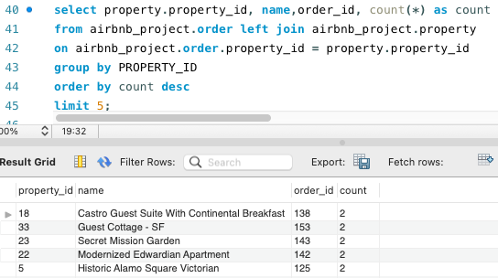
4. What are the top 5 properties in the Bay Area? (Based on number of bookings)
With Joins

Slide 16
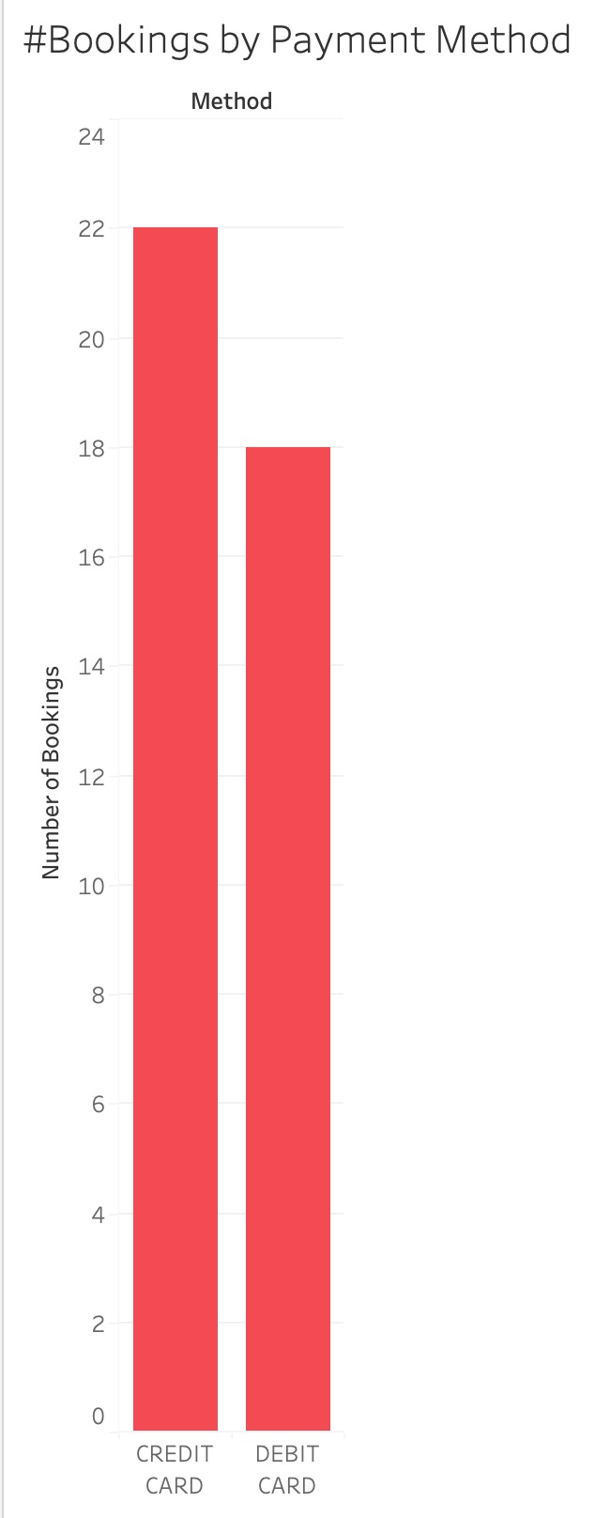
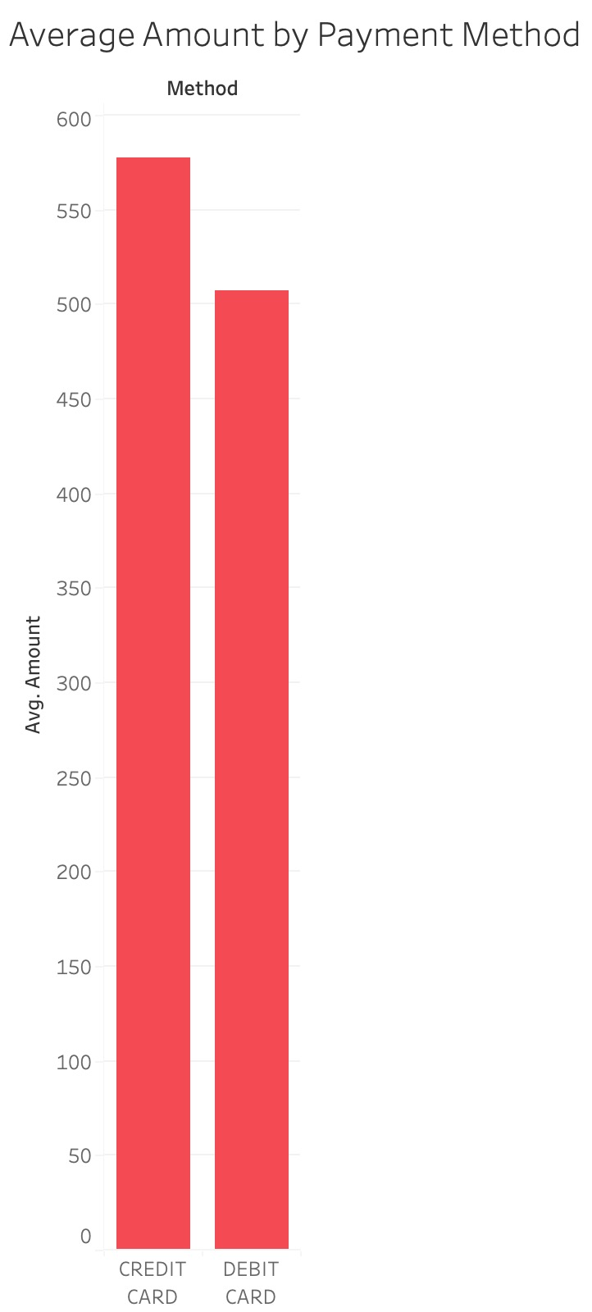
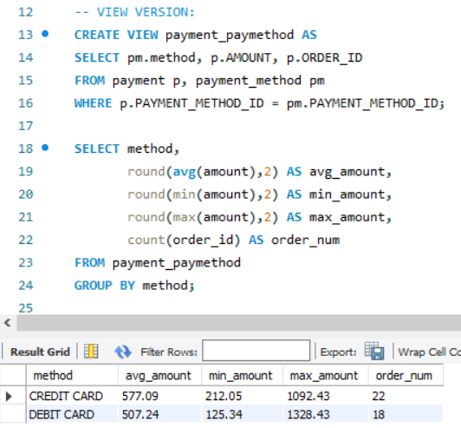
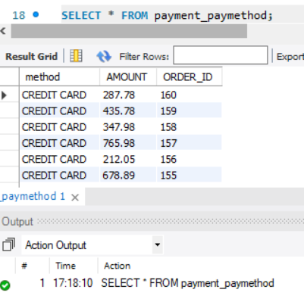
5. Is payment method correlated with spend? (average, min, max amount per order from different types of payment methods)
Using Views
VIEW of
payment_paymethod
People tend to use Credit card more often while booking. Also, the average spend is higher on Credit Card.

Slide 17
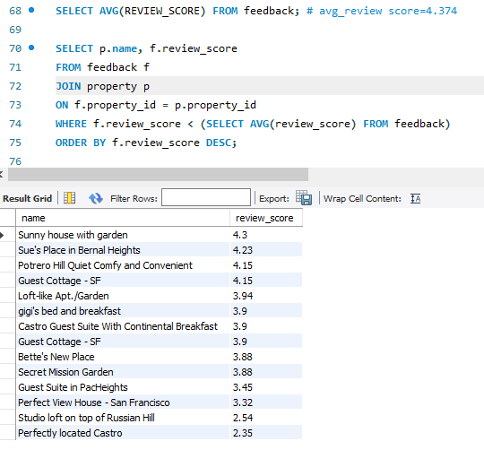
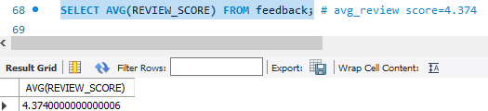
6. Which properties have a review score lower than average review score?
Using Joins, Subqueries

Slide 18
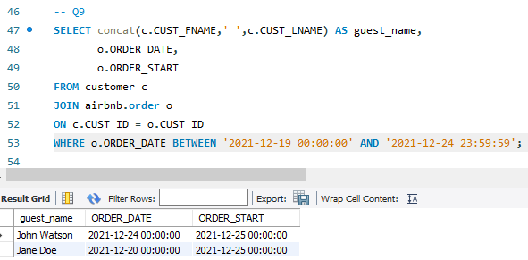
7. Who made the orders just before holidays (Dec 19 to Dec 24, 2021)?
Using Joins

Slide 19
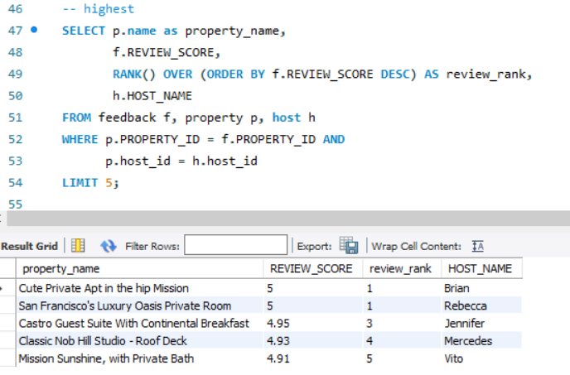
8. What are the properties having highest review score, and who’s the host for that? (Rank the top 5 properties with review score.)
Using Equi Joins & Rank

Slide 20
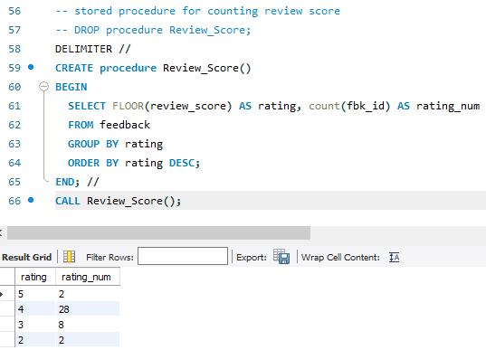
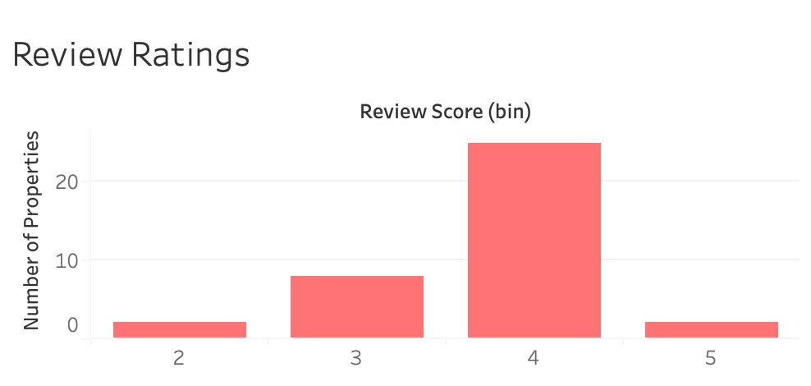
9. What is the frequency of different review ratings?
Using Stored Procedure

Slide 21
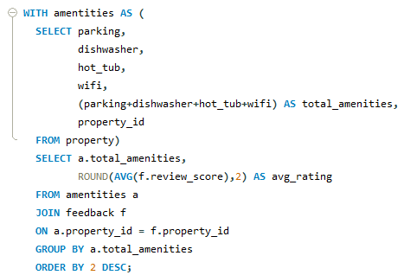
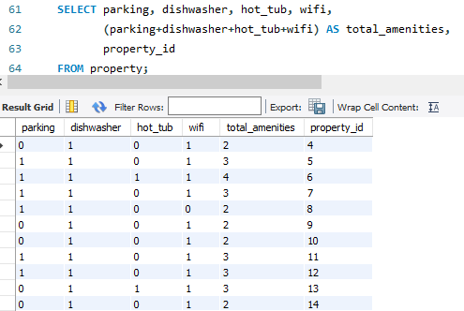
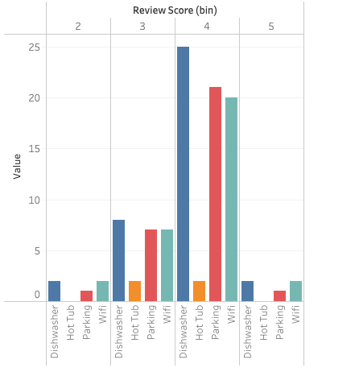
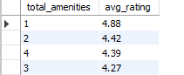
10. Do properties with more amenities get higher ratings?
Using Joins, Subqueries

Slide 22
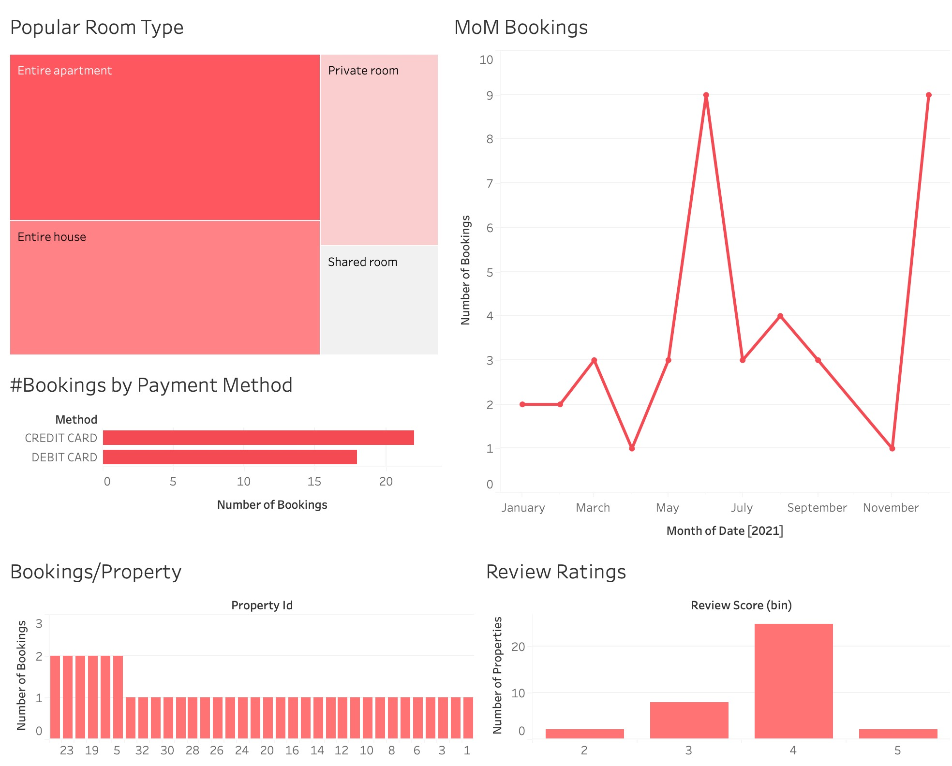
Data Visualization
Created Dashboard using Tableau version 2021.4
-Step 1: Upload the CSVs on Tableau and create ER diagram
-Step2: Build multiple “Sheets” with graphs visualizing Business Queries that we are exploring
-Step 3: Combine different Sheets to form a Business “Dashboard” for Airbnb

Slide 23



Learnings
 | Learning | Details
1 | Swim Lane Diagram with draw.io | Understanding of the guest and host journey maps
2 | ER Diagram with MySQL | Understanding of the relationship between tables in a database
3 | Database Creation using different entities involved in an Airbnb | Using CSV upload for large tables (Guest, Host, Property, Feedback, Booking, Payment) & INSERT for small tables (Room type, Payment Method)
4 | SQL concepts - DDL, DML & DQL | Used SQL Joins, Views, Subqueries and Stored Procedures
5 | Visualization with Tableau | To create dashboard and graphs relevant to business queries

Slide 24
Conclusion
This project helped us analyse
How Airbnb facilitates the guests and hosts: Various working spects from discovery to sale of an online marketplace
Factors that contribute to a property getting booked (amenities, room type, review ratings, seasonality etc.)
Business trends and queries that Airbnb might be interested in tracking
Order Bookings:
When customers orders on the Airbnb website for a stay, nhost can simply receive a message and review the customer information to decide whether he want to accept the order.
Airbnb Platform:
Customers select the favorite property to stay and review its rating and amenities. Hosts can post their place where they want to rent on the platform. Payment will also be issued through Airbnb security website.
Feedback:
After a sweet stay, both customers and host can leave a feedback/review to each other, which affects the ranking order of the property and the credit on guests.

Slide 25


Thank you
Happy Valentine’s!

